Slide 1
Data Structures
Programming Project #2

Slide 2
Data Center
A data center consists of multiple severs
The servers are connected by switches in a local area network
destination
source

Slide 3
Switches
Each switch has multiple ports
Receive and forward the packets from a port to another port

Slide 4
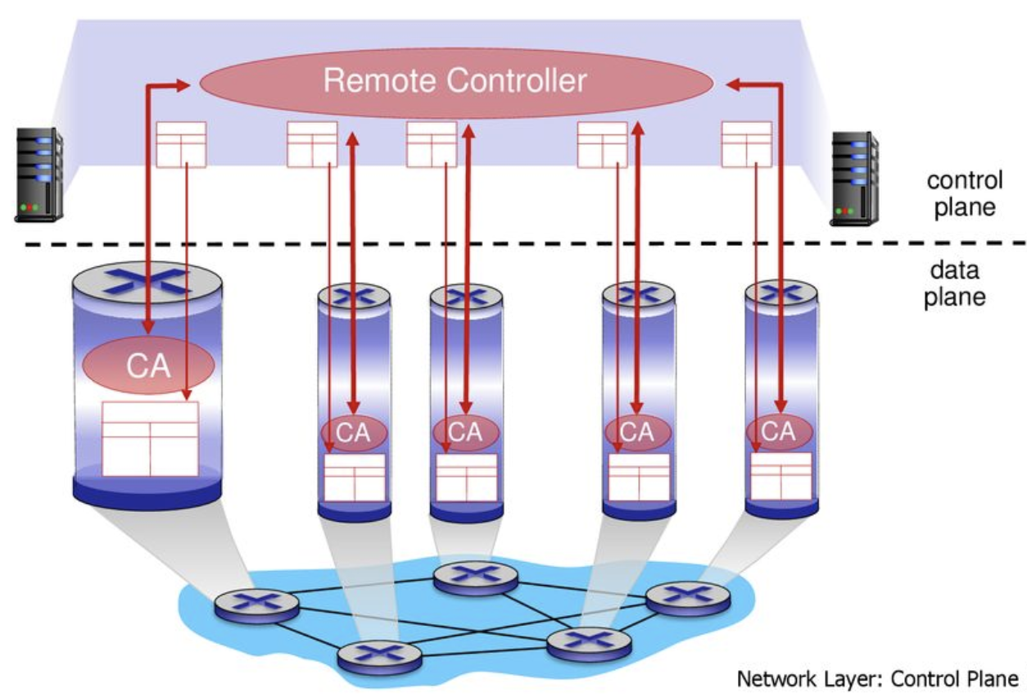
SDN-enabled Switches
A centralized controller is introduced – software-defined networking (SDN)

Slide 5
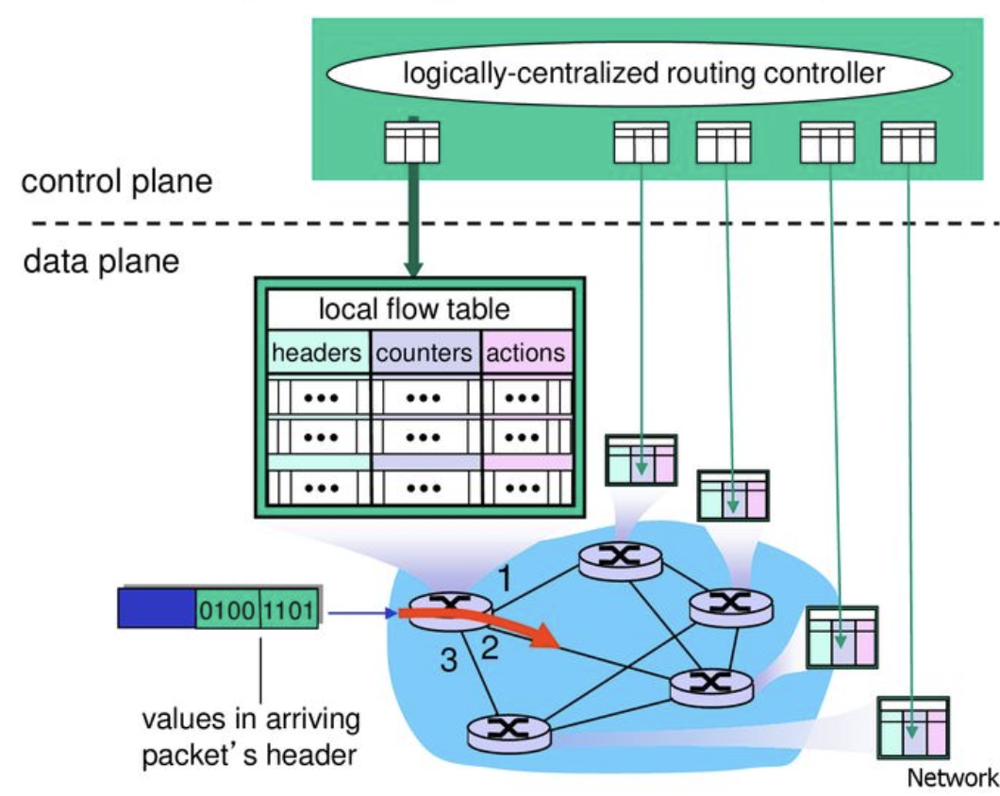
Installing Rules in the SDN-enabled Switches

Slide 6
Routing Path Update (aka Network Update)
Given: the old and new destination-based routing tree
Update the destination-based routing tree
1
3
1
3
Destination
0
2
4
0
2
4
Node ID
0 | 1 | 2 | 3 | 4
1 | 3 | 3 | 4 | -1
Node ID
0 | 1 | 2 | 3 | 4
3 | 3 | 4 | 2 | -1
To
To

Slide 7
Difficulty of Network Update in SDN
The controller is logically-centralized
However, the underlying mechanism is distributed
Each switch receives the update message and updates its rule independently and asynchronously
loop
1
3
1
3
Destination
drop
0
2
4
0
2
4
Node ID
0 | 1 | 2 | 3 | 4
1 | 3 | 3 | 4 | -1
Node ID
0 | 1 | 2 | 3 | 4
1 | 3 | 3 | 2 | -1
To
To

Slide 8
Difficulty of Network Update in SDN
The controller is logically-centralized
However, the underlying mechanism is distributed
Each switch receives the update message and updates its rule independently and asynchronously
How to solve the issue?
Two-phase commit (SIGCOMM 2012)
Round-based update for routing trees (HotNets, 2013)
Round-based update for single paths (TON, 2018)
“Survey of Consistent Software-Defined Network Updates”, in IEEE Communications Surveys & Tutorials, 2019

Slide 9

Difficulty of Network Update in SDN
Two-phase commit (SIGCOMM 2012)
Drawback: waste the TCAM size during the update
1
3
0
2
4
#Final
#Initial
#T
#F

Slide 10
Difficulty of Network Update in SDN
Round-based update (單純概念介紹)
Step 2: Update 0 and 2
1
3
1
3
0
2
4
0
2
4
Step 1: No update 1
Step 3: Update 3
1
3
1
3
0
2
4
0
2
4

Slide 11
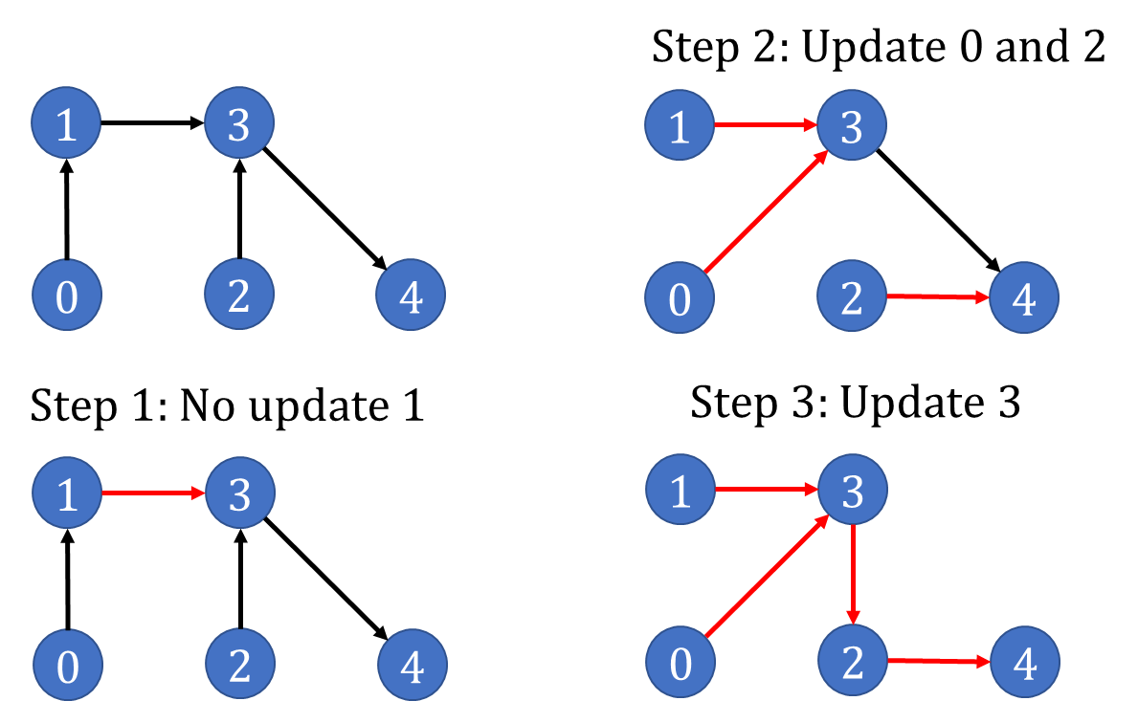
Programming Project #2: Minimize the number of update rounds
Input:
Numbers of nodes
Nodes in old and new routing trees
Procedure:
Minimize the rounds of update
Output:
Rules of each switch in each round
The grade is inversely proportional to the number of rounds

Slide 12
Programming Project #2: Minimize the number of update rounds
Input:
Numbers of nodes
Nodes in old and new routing trees
Procedure:
Minimize the rounds of update
Output:
Rules of each switch in each round
The grade is inversely proportional to the number of rounds
…

Slide 13
Programming Project #2: Minimize the number of update rounds
Input:
Numbers of nodes
Nodes in old and new routing trees
Procedure:
Minimize the rounds of update
Output:
Rules of each switch in each round
The grade is inversely proportional to the number of rounds
怎麼辦

Slide 14
Programming Project #2: Minimize the number of update rounds
Input:
Numbers of nodes
Nodes in old and new routing trees
Procedure:
Minimize the rounds of update
Output:
Rules of each switch in each round
The grade is inversely proportional to the number of rounds
早知道不加簽了

Slide 15
Programming Project #2: Round-based network update
Input:
Numbers of nodes
Nodes in old and new routing trees
Procedure:
Minimize the rounds of update
Output:
Rules of each switch in each round
Implement a given algorithm.
好啦~ 騙你的

Slide 16
Round-Based Update Algorithm (HotNets, 2013)
Black line: old tree Red line: new tree
1
3
1
3
Destination
0
2
4
0
2
4
Node ID
0 | 1 | 2 | 3 | 4
1 | 3 | 3 | 4 | -1
Node ID
0 | 1 | 2 | 3 | 4
3 | 3 | 4 | 2 | -1
To
To

Slide 17
Round-Based Update Algorithm (HotNets, 2013)
Black line: old tree Red line: new tree
1
3
1
3
drop
Destination
0
2
4
0
2
4
Node ID
0 | 1 | 2 | 3 | 4
1 | 3 | 3 | 4 | -1
Node ID
0 | 1 | 2 | 3 | 4
3 | 3 | 3 | 2 | -1
To
To

Slide 18
Round-Based Update Algorithm (HotNets, 2013)
Black line: old tree Red line: new tree
A node can safely update to new rules after its parent has switched
1
3
1
3
Destination
0
2
4
0
2
4
Node ID
0 | 1 | 2 | 3 | 4
1 | 3 | 3 | 4 | -1
Node ID
0 | 1 | 2 | 3 | 4
3 | 3 | 4 | 2 | -1
To/Parent
To/Parent

Slide 19
Round-Based Update Algorithm (HotNets, 2013)
Black line: old tree Red line: new tree
A node can safely update to new rules after its parent has switched
1
3
1
3
Destination
0
2
4
0
2
4
Node ID
0 | 1 | 2 | 3 | 4
1 | 3 | 3 | 4 | -1
Node ID
0 | 1 | 2 | 3 | 4
3 | 3 | 4 | 2 | -1
To/Parent
To/Parent

Slide 20
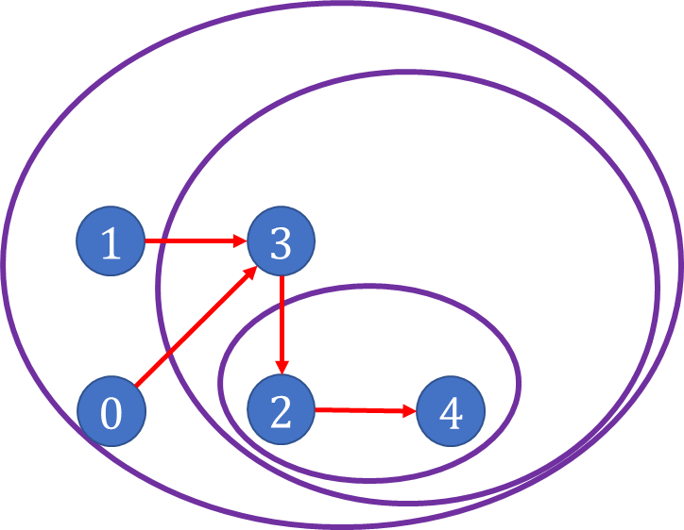
Round-Based Update Algorithm (HotNets, 2013)
Black line: old tree Red line: new tree
Step 2: Update 3
1
3
1
3
0
2
4
0
2
4
Step 1: Update 2
Step 3: Update 0 and 1
1
3
1
3
0
2
4
0
2
4

Slide 21
Requirement
You have to:
Use a linked list to save the children for each node
Use a pointer to save the parent for each node
You can use the structure like this:
typedef struct node* NodePtr; typedef struct Node { int id; ListNodePtr children; NodePtr parent; };
typedef struct ListNode* ListNodePtr; typedef struct ListNode { NodePtr data; ListNodePtr link; };
NodePtr switches = malloc (sizeof(Node)*num_of_nodes);

Slide 22
Discussion
Minimizing the number of update rounds is NP-hard
You cannot find an efficient algorithm for this problem unless NP = P
There are many heuristic algorithms
“Loop-Free Route Updates for Software-Defined Networks,” in IEEE/ACM TON 2018 (上一屆實作的）
“On Consistent Updates in Software Defined Networks”, in ACM HotNets 2013. (你們要實作的）
…

Slide 23
Input Sample: use scanf
1
3
Des
Format:
#Nodes
Tree1
Tree2
e.g.,
5
1 3 3 4 -1
3 3 4 2 -1
0
2
4
Node ID
0 | 1 | 2 | 3 | 4
1 | 3 | 3 | 4 | -1
To/Parent
1
3
0
2
4
Node ID
0 | 1 | 2 | 3 | 4
3 | 3 | 4 | 2 | -1
To/Parent

Slide 24
Output Sample: use printf
Format:
#Rounds
Tree1
Tree2
…
e.g.,
4
1 3 3 4 -1
1 3 4 4 -1
1 3 4 2 -1
3 3 4 2 -1
Node ID
0 | 1 | 2 | 3 | 4
1 | 3 | 3 | 4 | -1
To/Parent
Node ID
0 | 1 | 2 | 3 | 4
1 | 3 | 4 | 4 | -1
To/Parent
Node ID
0 | 1 | 2 | 3 | 4
1 | 3 | 4 | 2 | -1
To/Parent
Node ID
0 | 1 | 2 | 3 | 4
3 | 3 | 4 | 2 | -1
To/Parent

Slide 25
Note
Superb deadline: 10/27 Tue
Deadline: 11/03 Tue
Submit your code to E-course2
Demonstrate your code in 工院1館 401B
C Source code (not C++; compiled with gcc, not g++)
Show a good programming style

